Slide 1
Model answers
Dr.sandhiya rani.v,
Primary DNB OBG RESIDENT,
General hospital,
Doddaballapura.

Slide 2
Question No.2
A).LIST THE VARIOUS MODALITIES OF TREATMENT of ECTOPIC PREGNANCY.
B)what is the criteria for patient selection for medical management of ectopic pregnancy?
C) Discuss various surgical procedures performed in management of ectopic pregnancy

Slide 3
Q2.A).LIST THE VARIOUS MODALITIES OF TREATMENT of ECTOPIC PREGNANCY.
Ectopic pregnancy is defined as the implantation of a fertilized egg outside the uterine cavity.
MC site (97%) -fallopian tube.
remaining 3%
cervix
ovary
peritoneal cavity
uterine scars

Slide 4
MODALITIES:
Expectant management
. Medical management
. Surgical management
. Surgically administered medical treatment(SAM).

Slide 5
Expectant management:
In select women, close observation, in anticipation that there will be spontaneous resorption of an ectopic pregnancy, is reasonable provided patient is hemodynamically stable and asymptomatic
Medical management :
Single dose regime
Mtx -Dosage 50mg/m2 Single im
Multiple dose regime
Methotrexate 1mg/kg on day 1,3,5,7 with folinic acid rescue 0.1mg/kg im on day 2,4,6,8
SURGICAL MANAGEMENT :
Surgery is the first line of treatment when Criteria for expectant and medical management are not met with
· Sac more than 35 mm
.Cardiac activity present
· Beta hCG more than 5000
·

Slide 6
Procedures: Salpingotomy, Salpingostomy, salpingectomy (definite treatment)
Surgically administered medical management
Under ultrasound guidance, direct injection of methotrexate, potassium chloride,hyperosmolar glucose and pge2-alpha have all been used.

Slide 7
Q2b)what is the criteria for patient selection for medical management of ectopic pregnancy?
Pregnancy confirmed:
Tubal, scar or
cervical ectopic.
Ultrasound criteria-
Mean GSD<35mm
Absent cardiac activity,
no signs of rupture.
Beta-hCG<1500 or
1500-5000*
Medical management
Single dose regime
Mtx -Dosage 50mg/m2 Single im
Multiple dose regime
Methotrexate 1mg/kg on day 1,3,5,7 with folinic acid rescue 0.1mg/kg im on day 2,4,6,8

Slide 8
Prerequisites
The above criteria met patients with hemodynamically stability.
The patients must be counselled about the procedure and need for regular follow up and repeated beta HCG testing and the results outcome.
The patients must accept to comply with this and need for surgical management if above treatment is failing all need to be explained and informed consent is obtained.
Contraindications of methotrexate
Hemodynamic instability.
Any Intrauterine pregnancy.
impending or ongoing rupture signs( pelvic or abdominal pain), immunodeficiency, active pulmonary disease and peptic ulcer disease
Hypersensitivity to MTX.
Breastfeeding.

Slide 9
Q2c) Discuss various surgical procedures performed in management of ectopic pregnancy
Surgery is the first line of treatment when:
1. Criteria for expectant and medical management are not met with
. -Sac more than 35 mm
-Cardiac activity present
· -Beta hCG more than 5000
-Significant pain and hemoperitoneum
2. Failure of expectant or medical management
3. Clinical status of patient warrants urgent intervention
4. Compliance to medical management is doubtful

Slide 10
Approaches
Laparoscopic
laparotomy
pRocedures
Conservative surgeries:
Salpingostomy
Salpingotomy
Radical surgeries
Salpingectomy.

Slide 11
Decision making
Approach depends on:
1. Clinical status of patient
2. Availability of laparoscopic facilities
3. Skill of the operating surgeon
Both the approaches are acceptable, especially in an emergency.
A laparoscopic surgical approach is preferable to an open approach.
A laparotomy is an acceptable alternative where there is no access or expertise in laparoscopy and especially in an acute clinical setting where operative intervention is a life-saving procedure.
Procedure selection mainly depend on fertility status of the patients and the previous history of tubal damage by ectopics or infectious disease like TB ,PID.

Slide 12
Definite surgeries
Salpingectomy
It is the most definite treatment at present to avoid the risk of recurrence in same tube
Complete or segmental removal of tube Preferred when the tube is ruptured and damaged
Can be performed by laparoscopy and laparotomy
Done for both ruptured and unruptured ectopics.
Procedure selection mainly depend on fertility status of the patients and the previous history of tubal damage by ectopics or infectious disease like TB
Excision of cornual region to avoid rare reoccurrence of pregnancy in tubal stump is not often used in practice.

Slide 13
Indications for Definite surgeries
When the tube cannot be saved due to damage
Recurrent ectopic pregnancy occuring in the same tube.
Completed family
Previous sterilization.

Slide 14
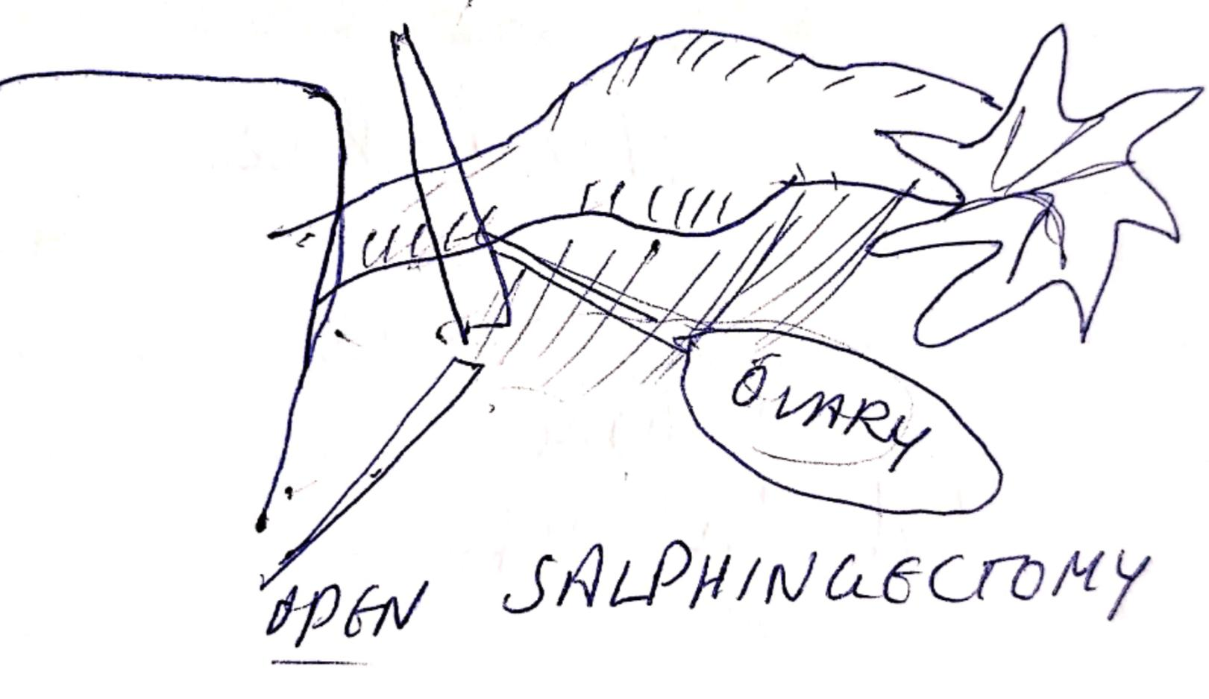
Salpingectomy

Slide 15
Conservative surgeries
Salpingostomy
Salpingotomy
Linear incision along the length of tube to enable removal of POCs
Preferred in unruptured ectopic
Incision is closed with 6-0vicryl or similar fine suture. This is not performed nowadays.
Prerequisites:
In women with a history of fertility-reducing factors
(previous ectopic pregnancy, contralateral tubal damage, previous abdominal surgery, previous pelvic inflammatory disease), Contralateral tube normal in fertility-desiring
Salpingostomy-A linear 1-1.5cm incision given with electric cautery on the antimesenteric border of the tube over the ectopic pregnancy sac.
Products usually extrude from incision and can be carefully removed or flushed out. Small bleeding sites are coagulated with cautery and the incision is left unstitched to heal by secondary intention.

Slide 16
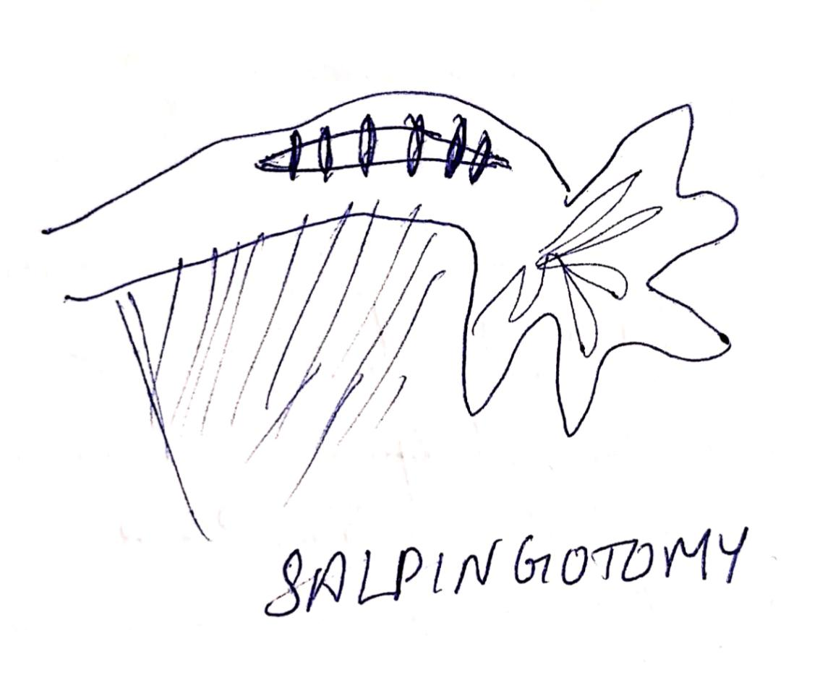
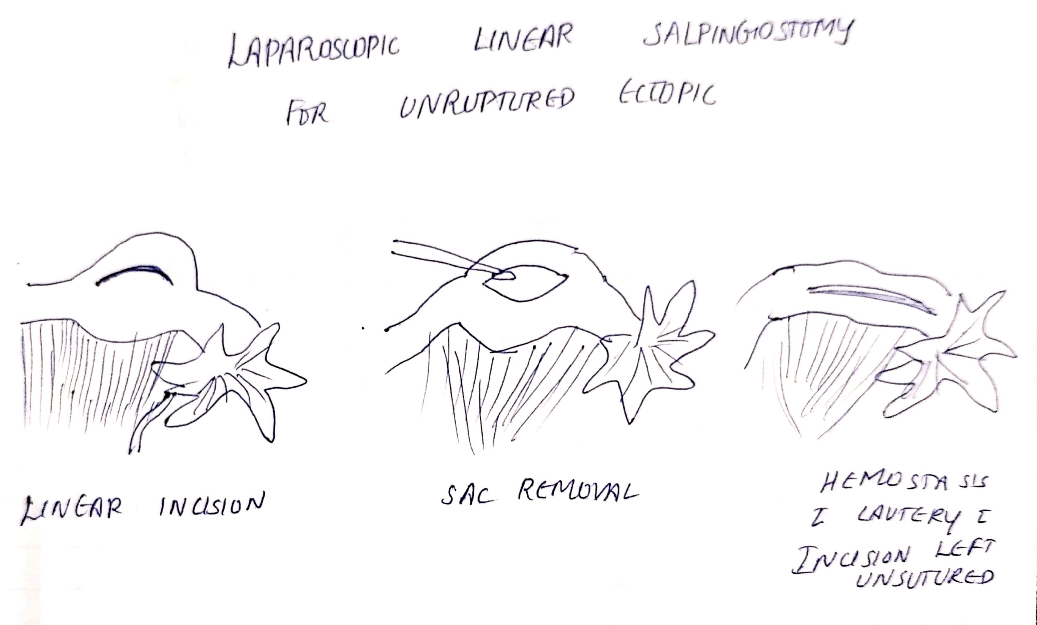

Slide 17
Other conservative surgeries
Segmental resection and anastomosis
Rarely performed
Milking of the tube or fimbrial evacuation
Done where products are easily dislodged from the fimbria.

Slide 18
Other ectopics management
Surgical Options
Suction and evacuation 2. Hysteroscopic resection undervision
Cervical
1. Laparoscopic or open cornual resection or salpingotomy- recommended approach
2. Hysterescopic resection under laparoscopic or usg guidance (Evidence is scant)
Additional measures to reduce bleeding:
Use of diluted vasopressin for local infiltration
2. Uterine artery ligation at origin
Interstitial

Slide 19
Cornual/
rudimentary horn
Option: laparoscopic or open excision of rudimentary horn
Attention to be paid to associated urinary tract anomalies
Ovarian
laparoscopic or open removal of gestational products by
enucleation or wedge resection

Slide 20
1. Suction evacuation or hysteroscopic guided resection
2. Laparotomy or laparoscopic approach – exposing the LUS by dissection the bladder and excision of the scar tissue with pregnancy --- reconstruction of LUS
3. Hysterectomy
Caesarean
Scar
pregnancy
Medical or conservative approach if intrauterine pregnancy non viable
Heterotropic
pregnancy

Slide 21
Early first trimester abdominal pregnancy – laparoscopic approach
Advanced abdominal pregnancy – laparotomy
The placenta may be left insitu if the vascular attachment involves vascular structures or vital organs. Await spontaneous absorption or use adjuvant treatment with methotrexate or selective arterial embolization.
Abdominal
ectopic

Slide 22
Post surgery
In either scenarios the tissue removed has to be sent for histopathology.
If a salpingotomy is performed, women should be informed about the risk of persistent trophoblast with the need for serum b-hCG level follow-up. They should also be counselled that there is a small risk that they may need further treatment in the form of systemic methotrexate or salpingectomy.
In India there is high prevalence of pelvic tuberculosis. This should be considered at the time of surgery for ectopic pregnancy. Appropriate sampling, testing and further treatment should be instituted for such situations.

